Slide 1
Honor.
Respect.
Remember.

Slide 2
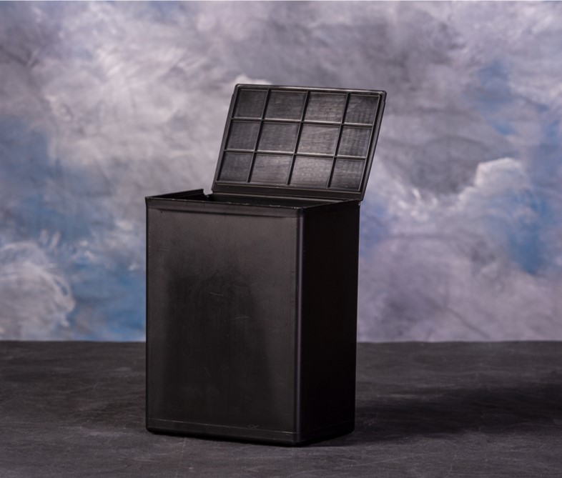
Temporary Urns
Temporary urns provided by funeral homes
Plastic with NO personal attributes in appearance
Most families choose this option since it’s free of charge

Slide 3
Custom Urns
Tailored to the military, can also be used for non-military
$150 Wholesale $300 Retail

Slide 4
Caisson Urns
Caisson holds temporary urn from funeral home
Bottom piece closes the bottom of Caisson once temporary urn is in place
Plaque temporarily attaches to front of Caisson using magnets
Customize Plaques with:
- Religious emblem
- Rank
- Branch of service
- Awards
- Other inscription if desired

Slide 5
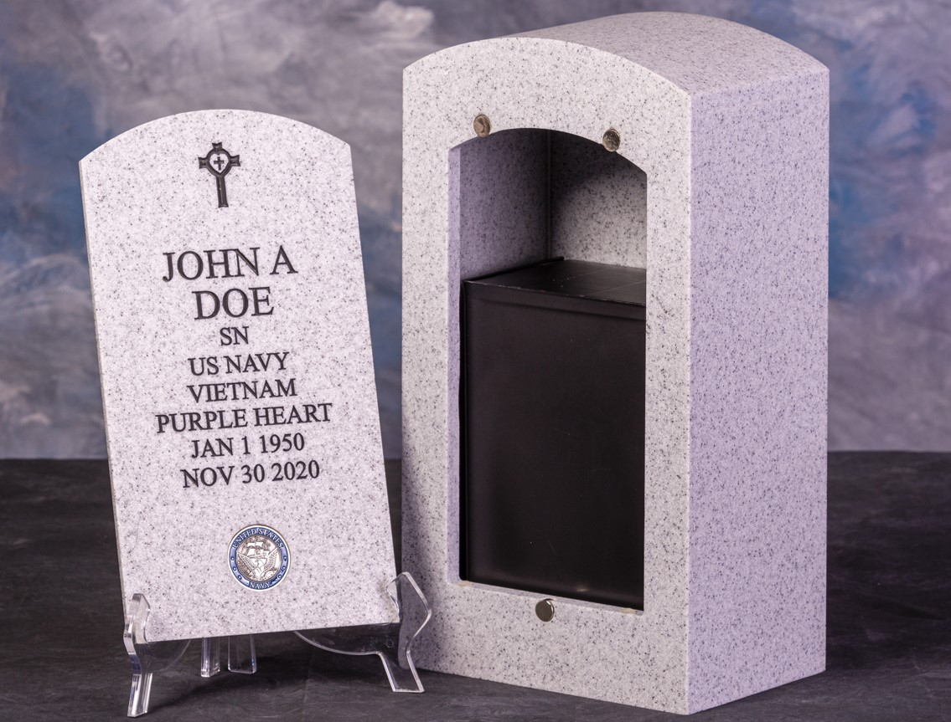
Temporary urn in Caisson

Slide 6
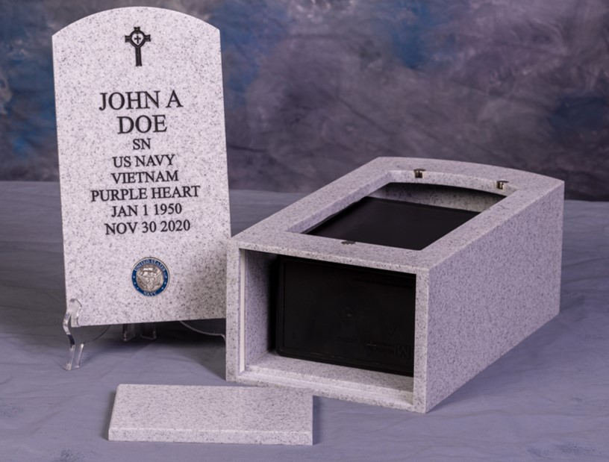
Bottom piece secured using a slide friction process

Slide 7
Caisson with plaque and temporary urn inside

Slide 8
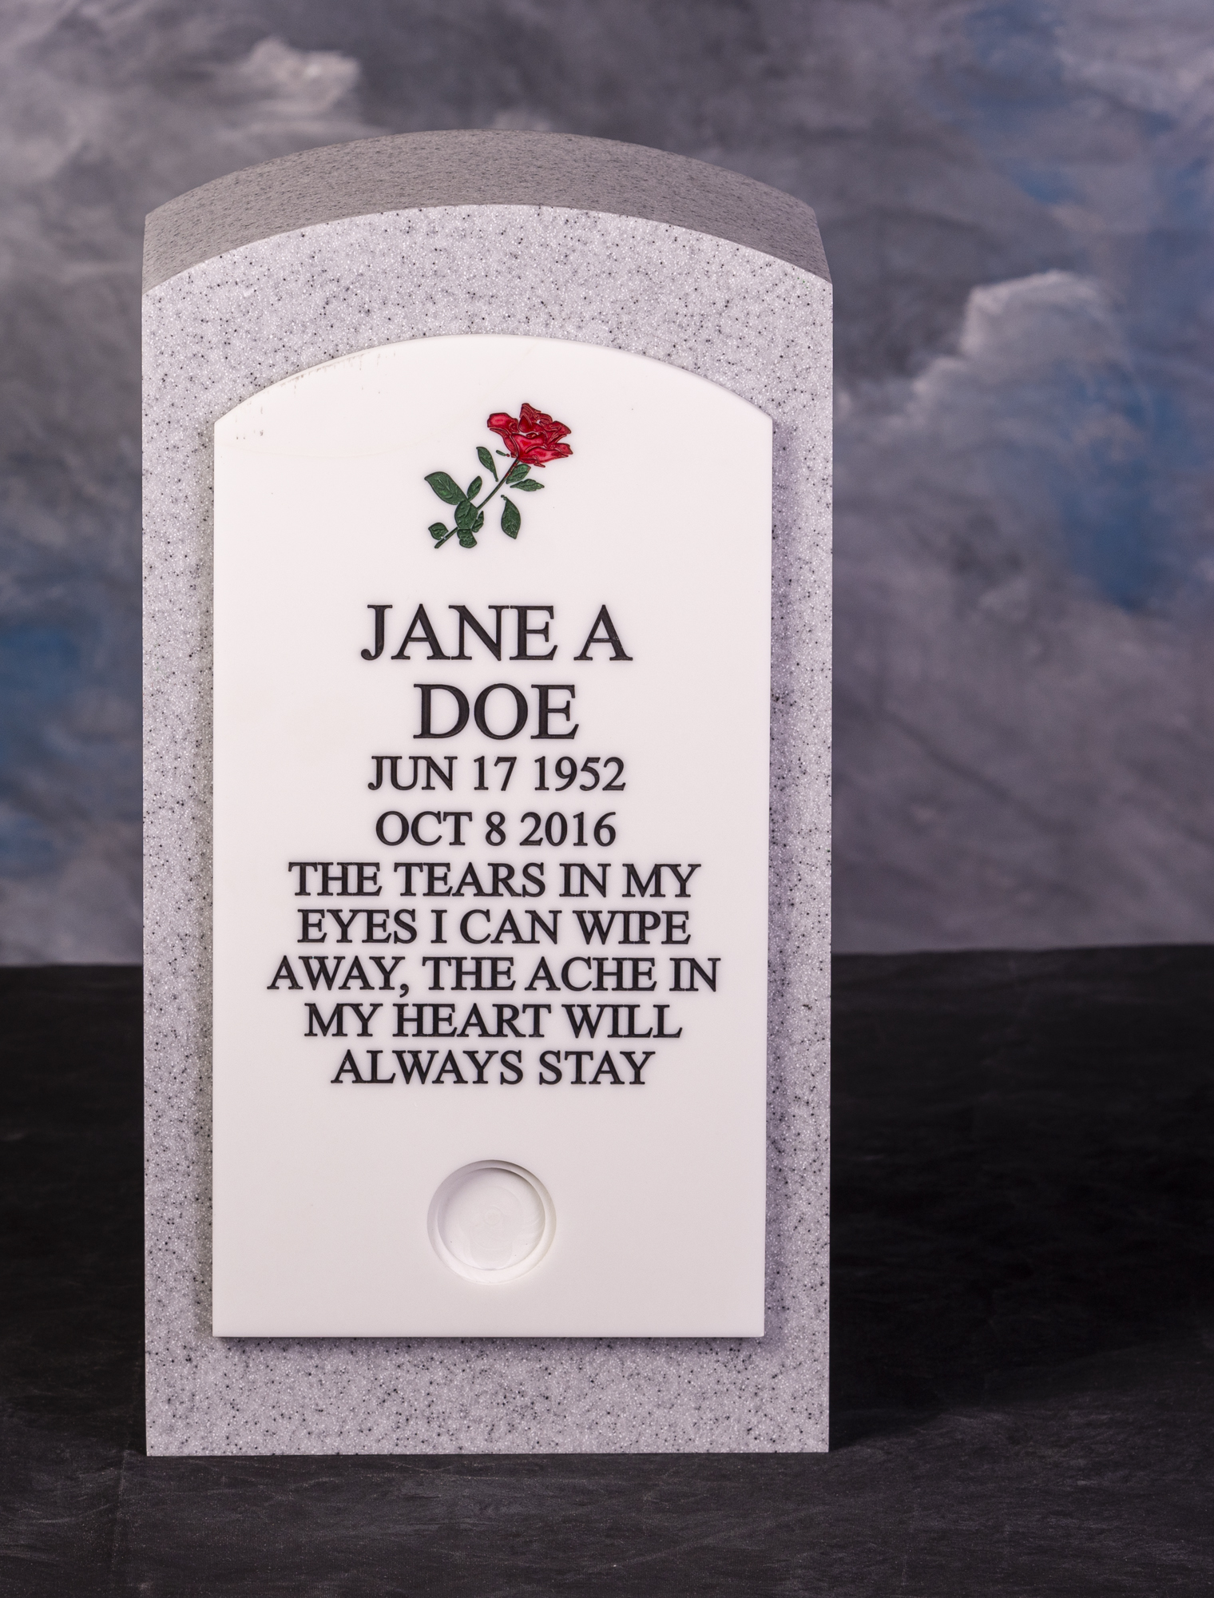
Urns, Caissons
& Plaques
Made with Wilsonart Solid Surface Material
Available in two colors:
- Steel Gray Tempest
- Frosty White
Made in the USA
Patented

Slide 9
HonorableMemories.com
Honorable Memories is a family owned and operated business. We pride ourselves in crafting custom designed urns that honors your loved ones.
Contact us today to learn more!
(701) 751-3975 • info@honorablememories.com

